Slide 1
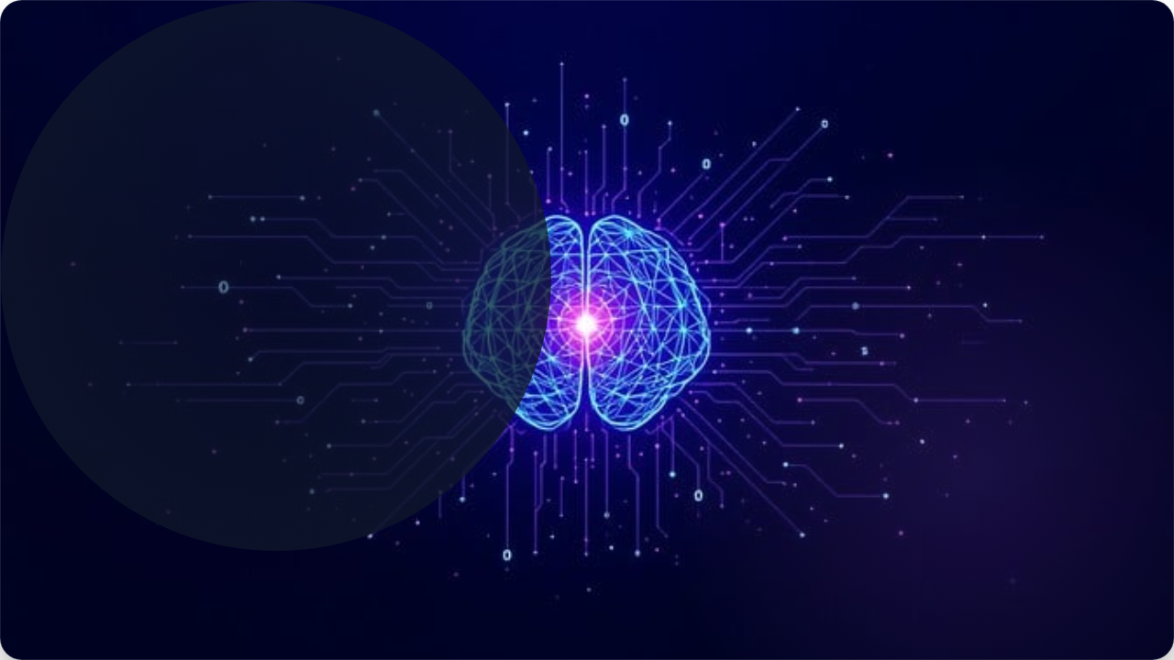
EmotionPulse AI
Next-Generation Customer Experience Automation. Powered by Empathy.

Slide 2




Problem Statement: The $3 Trillion Blind Spot
Systems are Emotionally Deaf
Current CRM and ticket systems are purely transactional. They categorize keywords, not human feelings.
No detection of Frustration Trends.
Generic bot replies escalate damage.

Slide 3


Our Approach: Sentient Automation
EmotionPulse AI
We analyze the full spectrum of customer communication (text, voice, email) using advanced AI models to produce actionable data points.
Emotion
Urgency
Intent

Slide 4




Who Needs The Pulse?
E-Commerce
Call Centers
Healthcare
Reduce basket abandonment.
Prioritize critical calls.
Flag patient anxiety.
Agencies
Detect client unhappiness.

Slide 5



The Zero-Cost AI Stack
Orchestration
n8n: The central automation hub. Handles triggering, data transformation, branching, and final actions.
Analysis
Whisper API: Audio-to-Text conversion. HuggingFace: Free inference APIs for emotion.

Slide 6
Full Workflow Diagram
01
Ingestion (Trigger)
WhatsApp / Email / Webhook
02
Classification (AI Analysis)
Whisper API + HuggingFace
03
Decision Gate (Logic)
IF/ELSE Risk Calculation

Slide 7



Deep Dive: Ingestion & Extraction
Trigger Nodes
Voice Processing
The workflow starts by listening for incoming data via Webhooks or polling APIs.
If audio is detected, the Whisper API node is activated.
Webhook: Real-time chats.
Polling: Email/WhatsApp.
Audio File → Clean Text

Slide 8
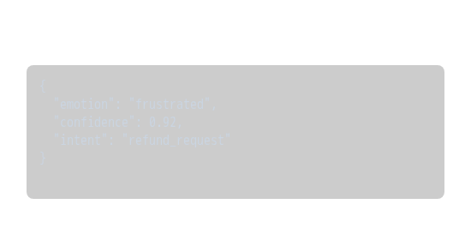
Deep Dive: Cognitive Analysis
Emotion Models
JSON Output Example
The cleaned text is sent to HuggingFace Inference API.
•
DistilRoBERTa: For general sentiment (Pos/Neg).
•
GoEmotions: For 28+ subtle emotions (Joy, Grief, Anger).

Slide 9


Deep Dive: Risk Calculation
The Risk Logic Engine
Implemented via a Code Node. It combines multiple factors to output a single score.
Formula:
IF (Angry AND Refund) OR (History > 3 Tickets) = CRITICAL

Slide 10
Risk Detection Matrix
Condition | Risk Score | Churn Risk | Action
Angry + Refund Request | CRITICAL | Yes | Escalate to Manager (P1)
Confused + Inquiry | MEDIUM | Low | Send RAG Explanation
Happy + Praise | LOW | No | Request Review

Slide 11

Deep Dive: Decision Gate
IF/ELSE Gateway
The traffic cop of the workflow. It routes data based on the calculated `risk_score`.
•
True Path: Critical Issues → Human Agent.
•
False Path: Routine Queries → AI Bot.

Slide 12



Automated Actions
High Risk Action
Slack Notification + P1 Ticket Creation + Compensation Template Draft.
Happy Action
Google Review Request + Discount Code + Upsell Workflow.

Slide 13



Tangible ROI
40%
75%
10x
Churn Reduction
Auto-Resolution
Efficiency

Slide 14
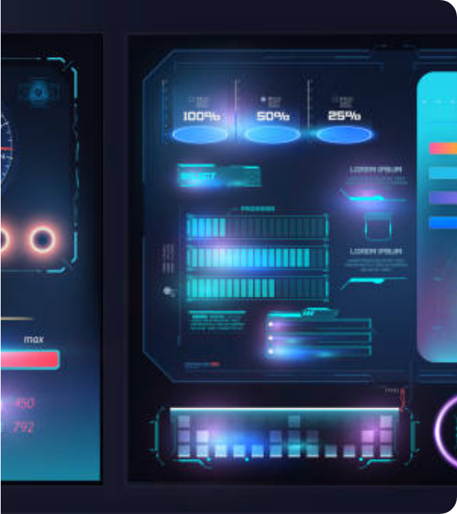
Future Roadmap
Predictive CX
Analyze sentiment trends over weeks to predict churn before it happens.
Real-time Voice
Intervene in live calls when stress levels peak using low-latency audio models.

Slide 15
The Empathy Era
"We aren't just automating workflows. We are automating care."

